Slide 1
Diversity at Cal Poly
Presented by: Hanna Wierszok, Ruojia Kuang

Slide 2
Why diversity is important?
Promote creative and critical thinking
Develop a broader understanding of the world
Advocate equity and social justice
Encourage collaboration
Prepare for the real world

Slide 3
Let's see how Cal Poly is doing!

Slide 4
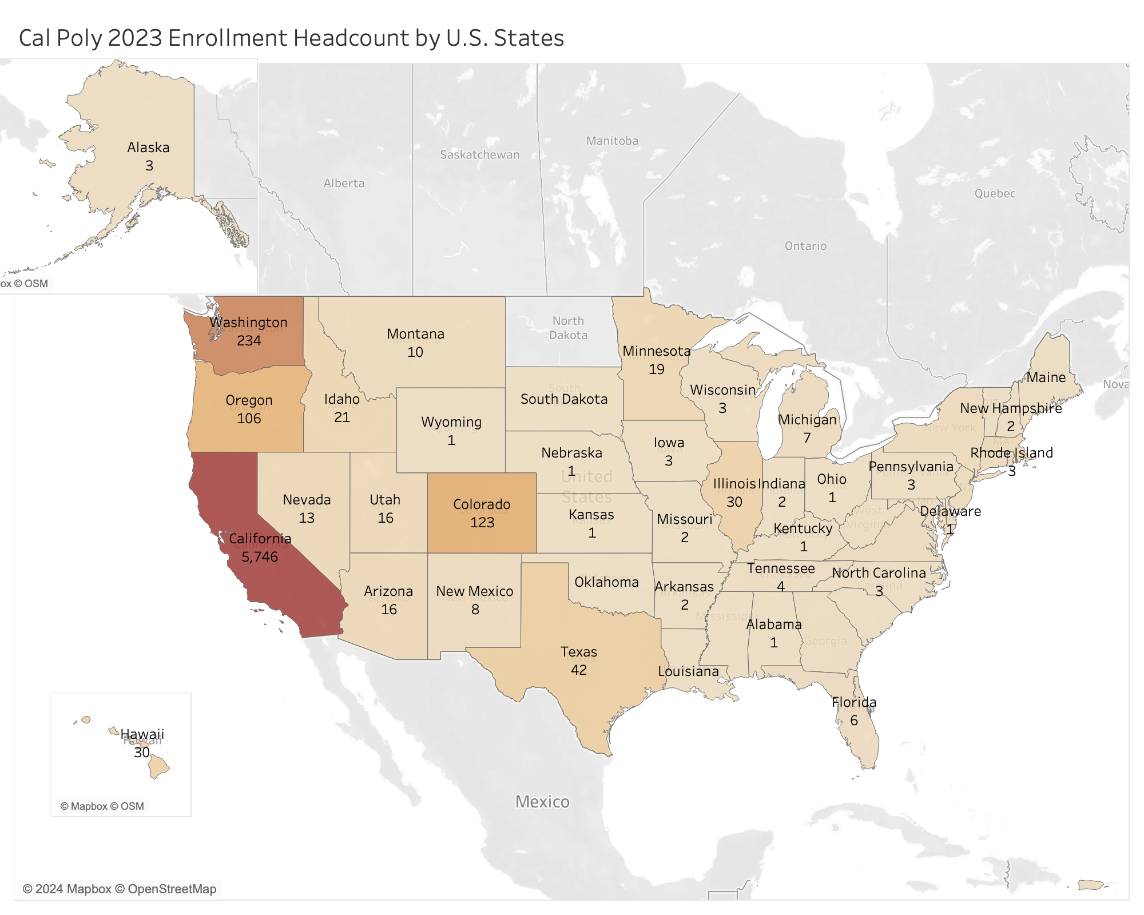

Slide 5
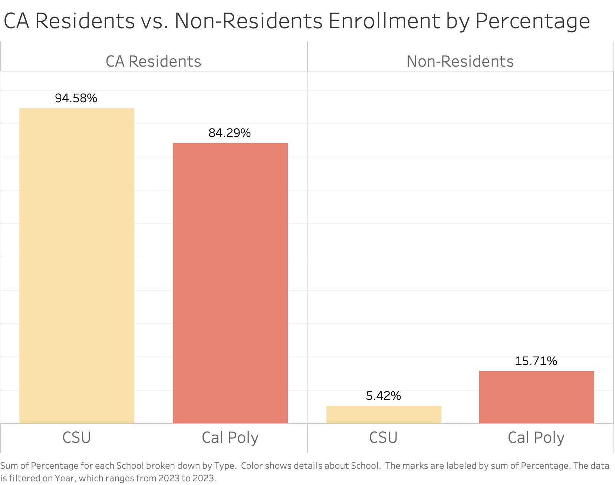

Slide 6
What Is Next?
Seems Cal Poly perform quite well in in-state vs. out-of-state comparison. Now let’s take a look at its ethnicity breakdowns.

Slide 7
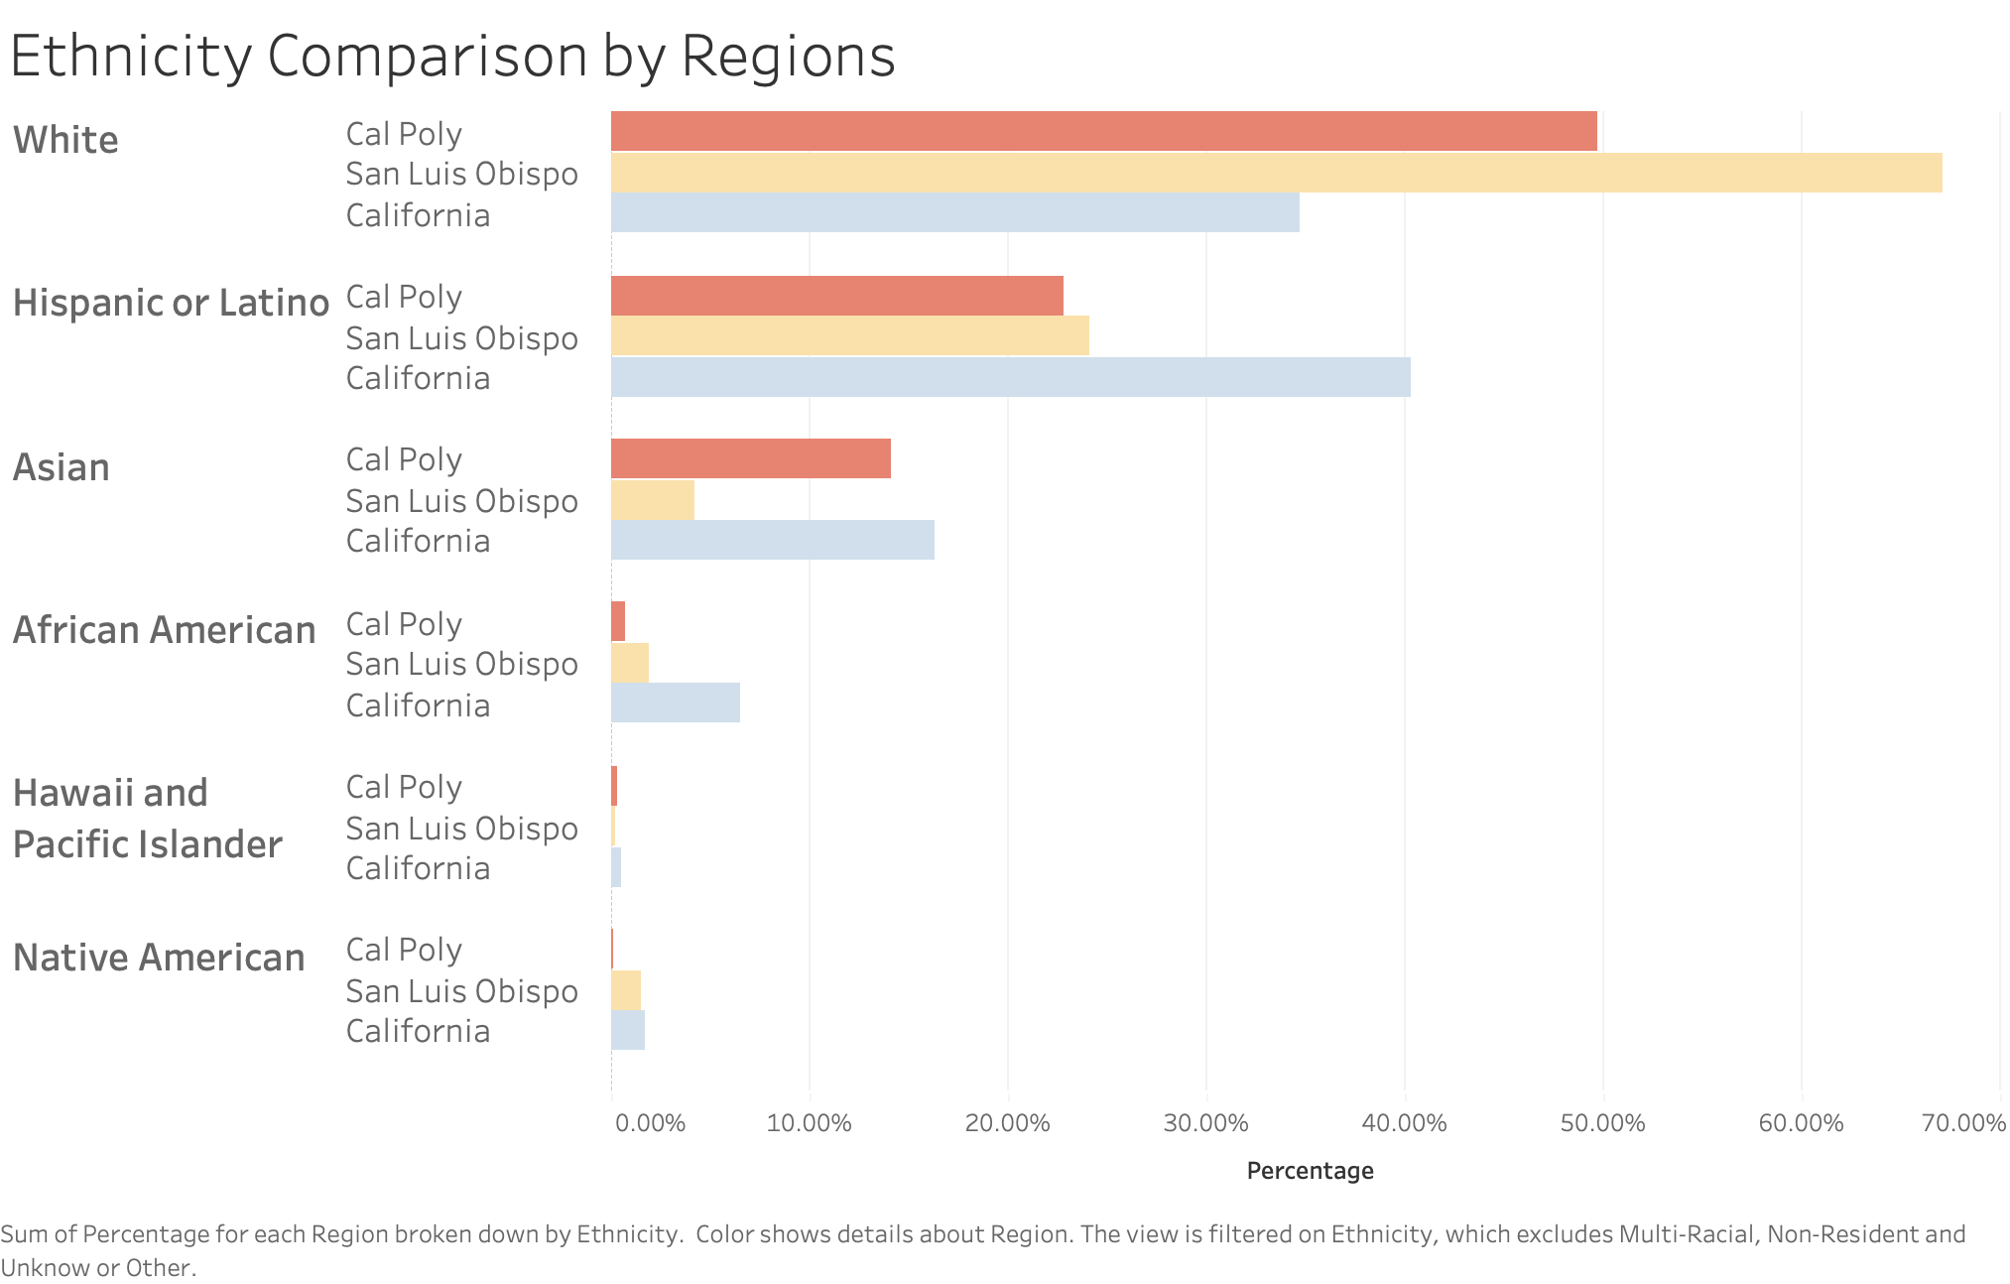
Do You Need a List?
You can describe an item from the list here
You can describe an item from the list here
You can describe an item from the list here
You can describe an item from the list here
You can describe an item from the list here

Slide 8
There is still room for improvement!
Cal Poly is good at
But is not good enough
Maybe should
Admitting more diverse groups than SLO demographic
Comparing to California demographic
Considering minorities more

Slide 9
International students matter too
International students account for 6% of the total U.S. higher education population
and …
Contributed nearly $38 BILLION to the U.S. economy

Slide 10
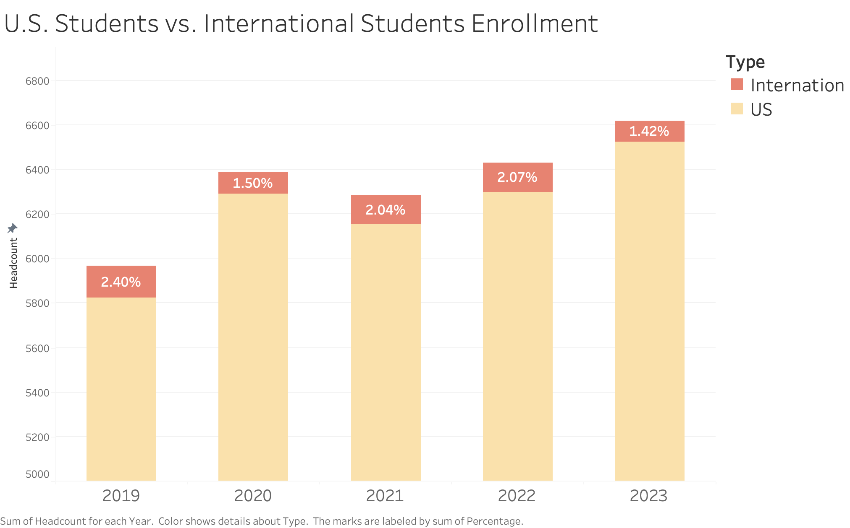
Mercury
Venus
Mercury is the smallest planet in the Solar System
It has a beautiful name and is the second planet from the Sun

Slide 11
Takeaways
How to support local California students
Why international students decreased in recent years
Give college application advice to friends or family who are considering attending college soon

Slide 12
Thank You!
Do you have any questions?

Slide 13
Resources
Cal Poly Enrollment Data
https://app.powerbi.com/view?r=eyJrIjoiM2NlN2ExMzctZWNmNC00M2E4LWE4NzMtMjRkNjM4MGQ3YmY3IiwidCI6IjFiMGQwMmRiLWZjOWUtNDQ5NS05NTM3LTFkMzc5Y2NhMmFlNyIsImMiOjZ9
CSU Enrollment Data
https://tableau.calstate.edu/views/SelfEnrollmentDashboard/EnrollmentSummary
California Census
https://www.census.gov/quickfacts/fact/table/CA/PST045223
San Luis Obispo, CA Census
https://www.census.gov/quickfacts/fact/table/sanluisobispocountycalifornia/PST045222
“United States Hosts Over 1 Million International Students, Fastest Enrollment Growth Rate in More Than 40 Years”, Institute of International Education (IIE), 13 Nov 2023.
https://www.iie.org/news/us-hosts-over-1-million-fastest-growth-for-40-years/#:~:text=International%20students%20accounted%20for%206,the%20U.S.%20Department%20of%20Commerce

